Slide 1
Chapter 2
Supply Chain Performance: Achieving Strategic Fit and Scope
Supply Chain Management
(3rd Edition)
2-<number>

Slide 2
Competitive and Supply
Chain Strategies
Competitive strategy: defines the set of customer needs a firm seeks to satisfy through its products and services
  Eg. Wal-mart aims to provide high availability of a variety of reasonable quality products at low prices (vs McMaster Carr)
  Eg. Dell stressed on customization and variety at reasonable cost (vs HP)
Supply chain strategy: determines the nature of material procurement, transportation of materials, manufacture of product or creation of service, distribution of product
  Consistency and support between supply chain strategy, competitive strategy, and other functional strategies is important
2-<number>

Slide 3
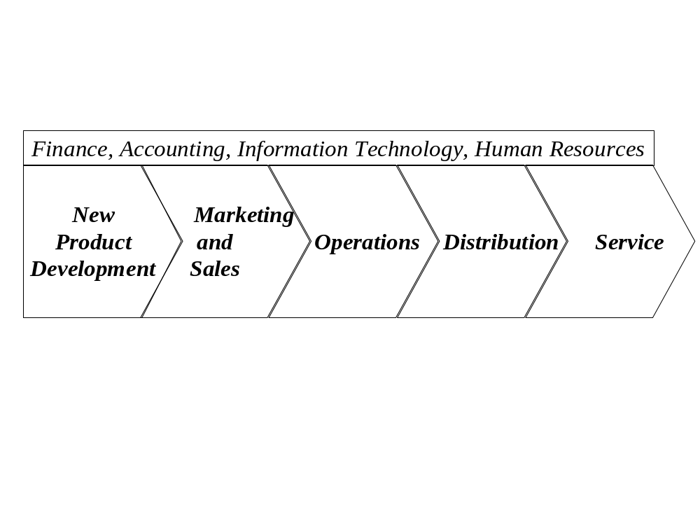
The Value Chain: Linking Supply Chain and Business Strategy
2-<number>

Slide 4
Achieving Strategic Fit
Strategic fit:
  Consistency between
  customer priorities that the competitive strategy hopes to satisfy and
  supply chain capabilities that the supply chain strategy aims to build
  Competitive and supply chain strategies have the same goals
All functions that are part of company’s value chain contribute to its success and failure (functional strategies)
These functions do not operate in isolation, failure at any one function may lead to failure of the overall chain.
2-<number>

Slide 5
How is Strategic Fit Achieved?
Step 1: Understanding the customer needs and supply chain uncertainty
Step 2: Understanding the supply chain capabilities
Step 3: Achieving strategic fit
2-<number>

Slide 6
Step 1: Understanding the Customer and Supply Chain Uncertainty
Identify the needs of the customer segment being served
Quantity of product needed in each lot (emergency-small)
Response time customers will tolerate (emergency-short)
Variety of products needed (high premium on availability)
Service level required (high availability on emergency)
Price of the product (less sensitive on emergency)
Desired rate of innovation in the product (high end dept store- expect high innovation)
2-<number>

Slide 7
Step 1: Understanding the Customer and Supply Chain Uncertainty
Implied demand uncertainty: resulting uncertainty for the supply chain given the portion of the demand the supply chain must handle and attributes the customer desires
Understanding the Customer
  Lot size
  Response time
  Service level
  Product variety
  Price
  Innovation
Implied
Demand
Uncertainty
2-<number>

Slide 8
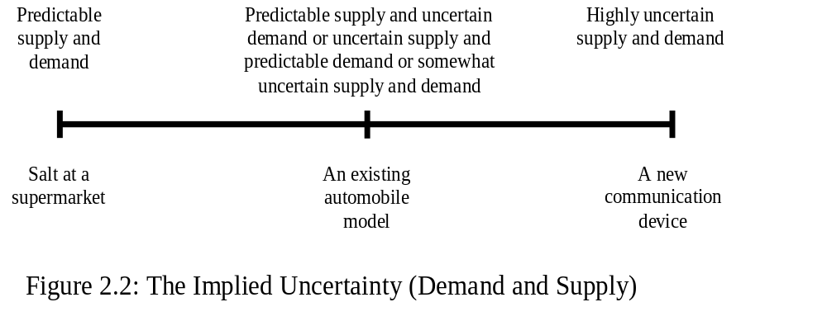
The Implied Uncertainty (Demand and Supply) Spectrum
2-<number>

Slide 9
Step 2: Understanding the
Supply Chain
How does the firm best meet demand in the uncertain environment?
Dimension describing the supply chain is the idea of the trade-off between supply chain responsiveness and efficiency
Supply chain responsiveness -- ability to
  respond to wide ranges of quantities demanded
  meet short lead times
  handle a large variety of products
  build highly innovative products
  meet a very high service level
2-<number>

Slide 10
Step 2: Understanding the
Supply Chain
There is a cost to achieving responsiveness
Supply chain efficiency: cost of making and delivering the product to the customer
Increasing responsiveness results in higher costs that lower efficiency
The Cost-Responsiveness efficient frontier is the curve showing the lowest possible cost for a given level of responsiveness
The efficient frontier represents the cost-responsiveness performance of the best supply chain
2-<number>

Slide 11
Understanding the Supply Chain: Cost-Responsiveness Efficient Frontier
Responsiveness
High
Low
Cost
High
Low
2-<number>

Slide 12
The Responsiveness Spectrum
Highly
efficient
Somewhat
efficient
Somewhat
responsive
Highly
responsive
Integrated
steel mill
(Production
Scheduled
in advance
with
Little flexibility)
Hanes
Apparel
(Traditional
Manufacturer
with longer
production
lead time)
Most
automotive
Production
(delivering
large variety
of products in
shorter
lead time)
Dell
(custom
made
PCs and
servers in
few days)
2-<number>

Slide 13
Step 3: Achieving Strategic Fit
We have looked at demand and supply and mapped both to gauge the level of implied uncertainty
We have examined a supply chain to understand where it lies on the responsiveness spectrum
Now it is to ensure that the degree of supply chain responsiveness should be consistent with the implied uncertainty of demand and supply
2-<number>

Slide 14
Achieving Strategic Fit Shown on the Uncertainty/Responsiveness Map (Fig. 2.5)
Responsive supply chain
Responsiveness spectrum
Zone of Strategic Fit
Efficient supply chain
Certain demand
Implied uncertainty spectrum
Uncertain demand
2-<number>

Slide 15
Step 3: Achieving Strategic Fit
All functions in the value chain must support the competitive strategy to achieve strategic fit.
Two extremes: Efficient supply chains (Barilla) and responsive supply chains (Dell)
Two key points
  there is no right supply chain strategy independent of competitive strategy
  there is a right supply chain strategy for a given competitive strategy
2-<number>

Slide 16
Comparison of Efficient and Responsive Supply Chains
 | Efficient | Responsive
Primary goal | Lowest cost | Quick response
Pricing strategy | Lower margins | Higher margins
Mfg strategy | High utilization | Capacity flexibility
Inventory strategy | Minimize inventory | Buffer inventory
Lead time strategy | Reduce but not at expense of greater cost | Aggressively reduce even if costs are significant
Supplier selection strategy | Cost and low quality | Speed, flexibility, quality
Transportation strategy | Greater reliance on low cost modes | Greater reliance on responsive (fast) modes
2-<number>

Slide 17
Other Issues Affecting Strategic Fit
Multiple products and customer segments
Product life cycle
Competitive changes over time
2-<number>

Slide 18
Multiple Products and
Customer Segments
Firms sell different products to different customer segments (with different implied demand uncertainty)
The supply chain has to be able to balance efficiency and responsiveness given its portfolio of products and customer segments
Two approaches:
  Different supply chains
  Tailor supply chain to best meet the needs of each product’s demand
2-<number>

Slide 19
Product Life Cycle
The demand characteristics of a product and the needs of a customer segment change as a product goes through its life cycle
Supply chain strategy must evolve throughout the life cycle
Early: uncertain demand, high margins (time is important), product availability is most important, cost is secondary
Late: predictable demand, lower margins, price is important
2-<number>

Slide 20
Competitive Changes Over Time
Competitive pressures can change over time
An increased emphasis on variety at a reasonable price results more competition
Requires a change in the firm’s competitive strategy
With the change in competitive strategy, a firm must also change its supply chain strategy to maintain strategic fit.
2-<number>

Slide 21
Obstacles to Achieving Strategic Fit
Increasing variety of products (Increase in variety tends to raise uncertainty)
Decreasing Product Life Cycles (Decrease in PLC increases uncertainty)
Increasingly Demanding Customers (Increase in demand requires more responsiveness, increases uncertainty)
Fragmentation of Supply Chain Ownership (reduction in supply chain co-ordination due to individual objectives)
Globalization (Increase in competition increases uncertainty)
Difficulty Executing New Strategies (Problem in executing new strategies)
2-<number>

Slide 22
Summary of Learning Objectives
Why is achieving strategic fit critical to a company’s overall success?
How does a company achieve strategic fit between its supply chain strategy and its competitive strategy?
2-<number>

